Slide 1
Structured Query Language (SQL)
Week 9
Dr. Farshid Keivanian

Slide 2
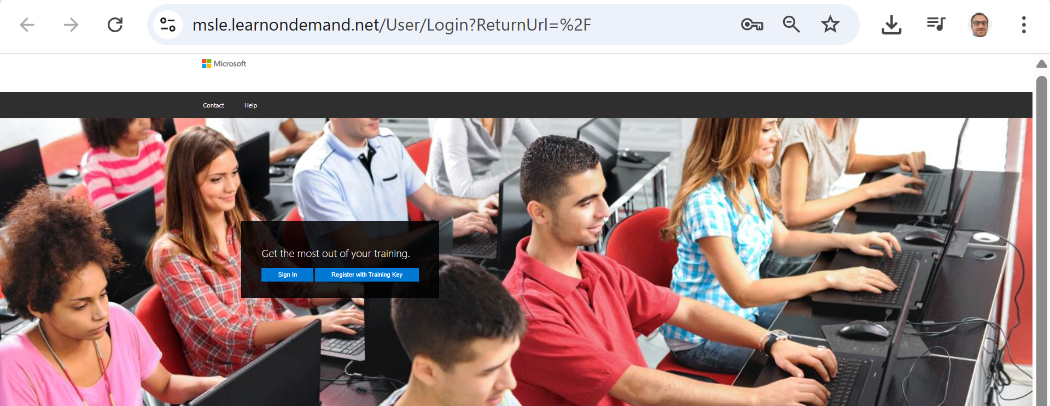
Week 9 Tutorial Activity (Step-by-Step)
Go to https://msle.learnondemand.net/

Slide 3
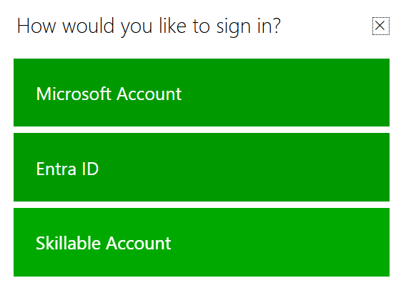
Week 9 Tutorial Activity (Step-by-Step)
If already registered and you want to log in
On the popup (as in your screenshot), choose Skillable Account.
Enter the username/email and password you created when you first registered with the key.
Once logged in, you’ll see your training dashboard → then launch Explore Azure SQL Database.

Slide 4
Week 9 Tutorial Activity (Step-by-Step)
If already registered and you want to log in
Don’t pick Microsoft Account or Entra ID unless your lab instructions specifically require it — those are for enterprise logins.

Slide 5
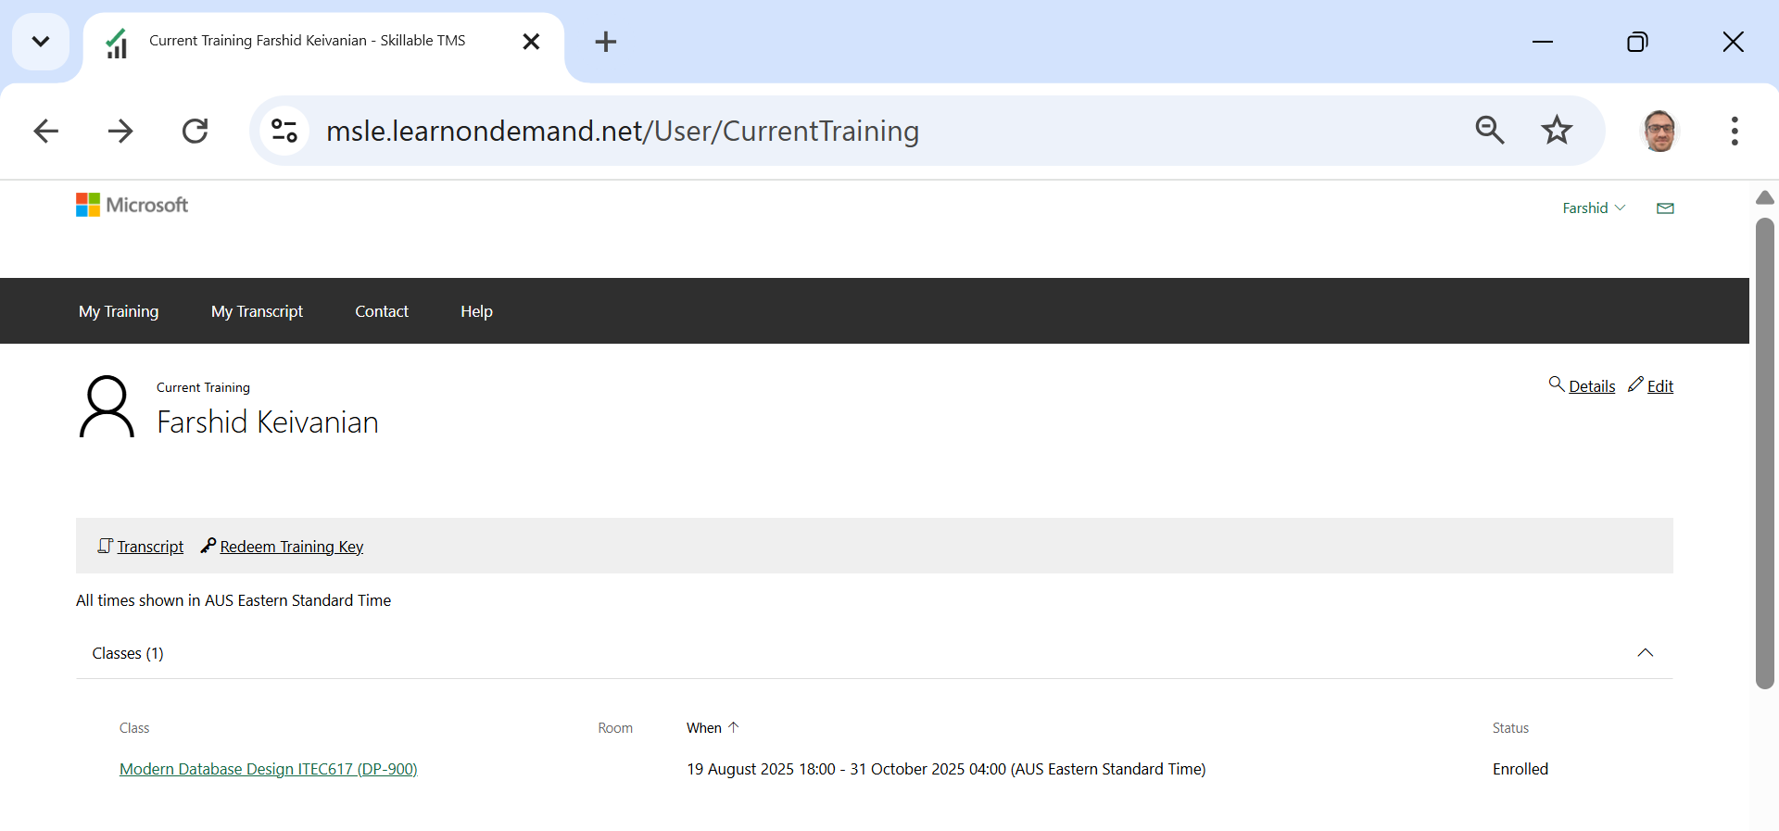
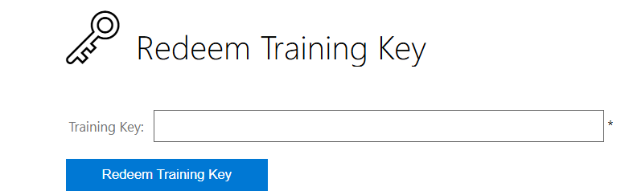
Week 9 Tutorial Activity (Step-by-Step)
If already registered and you want to log in
39595D4F29DCCDC7
39595D4F29DCCDC7

Slide 6
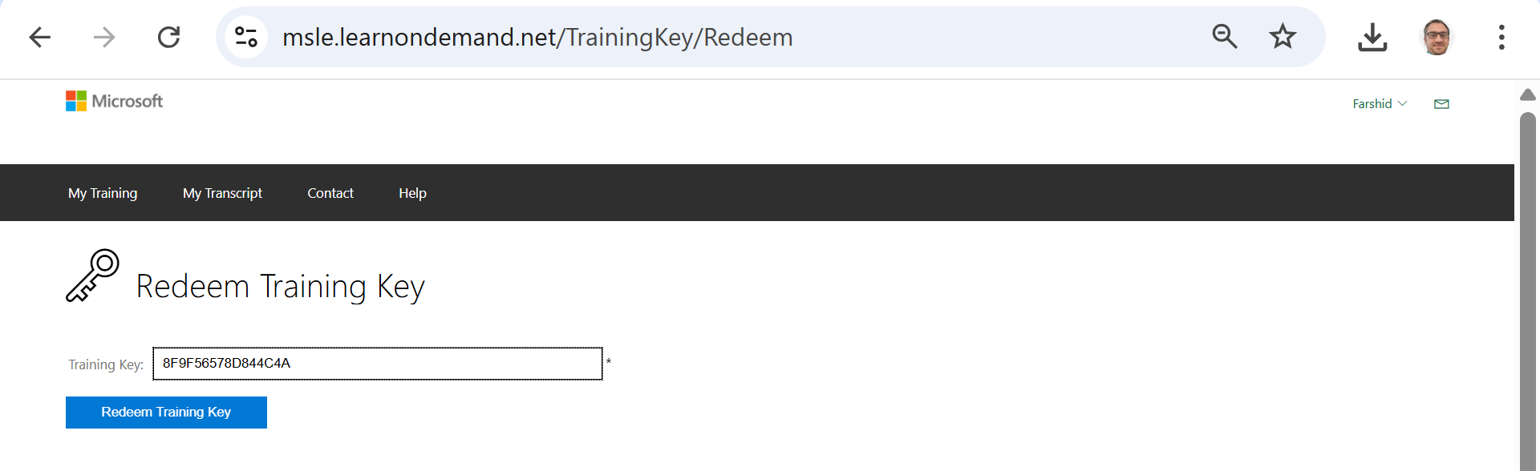
Week 9 Tutorial Activity (Step-by-Step)
39595D4F29DCCDC7

Slide 7
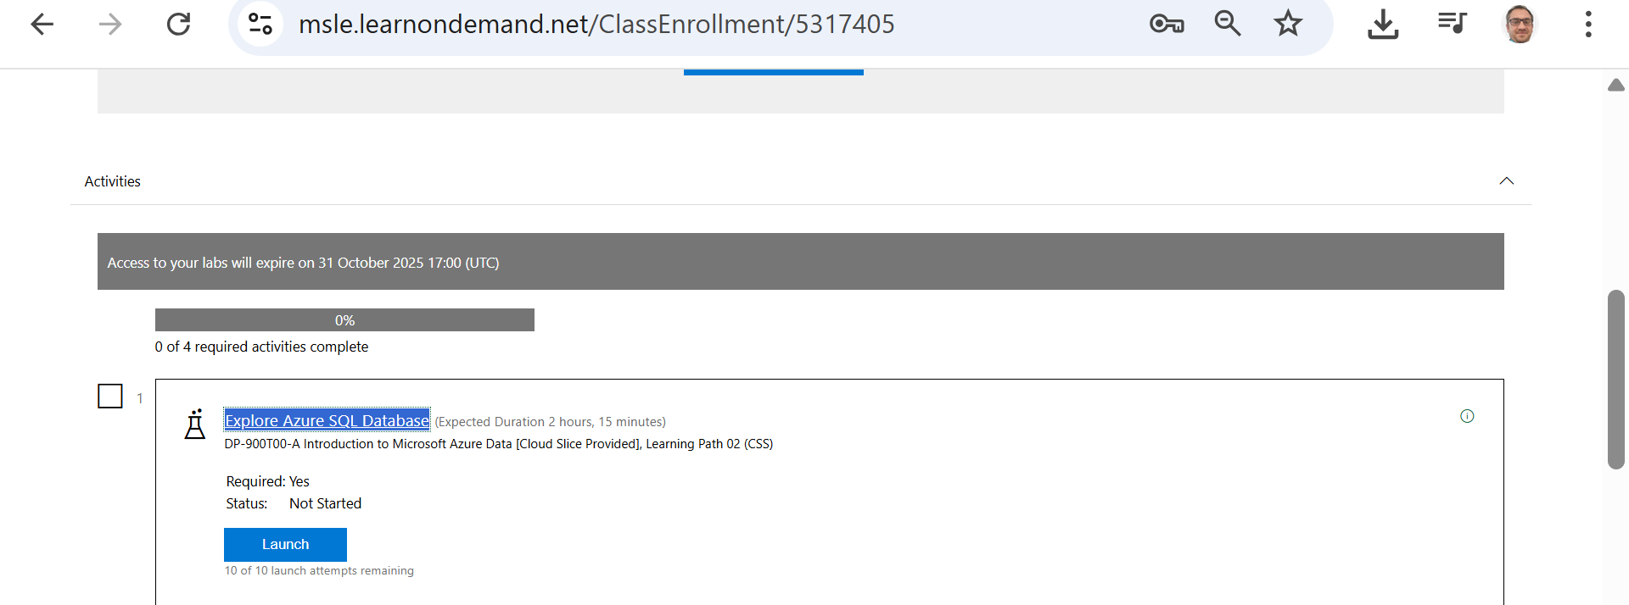
Week 9 Tutorial Activity (Step-by-Step)
Launch the lab “Explore Azure SQL Database”
Use the lab’s Azure username/password to sign in to the Azure Portal.
Click Start → Open Azure Portal and sign in with those credentials.

Slide 8
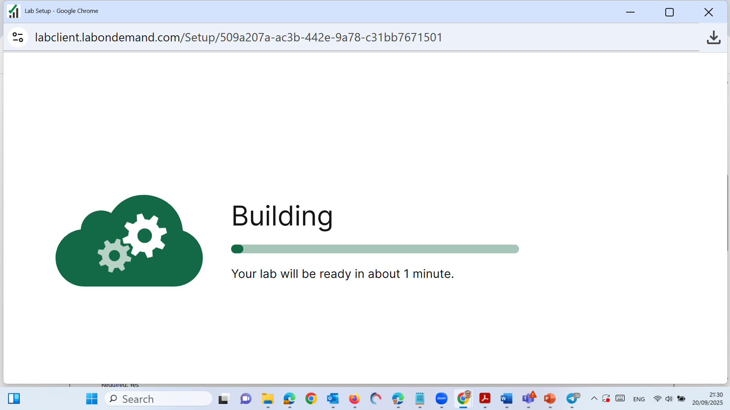
Week 9 Tutorial Activity (Step-by-Step)

Slide 9
Week 9 Tutorial Activity (Step-by-Step)
Follow the on-screen instructions in the right-hand side window of the virtual lab to log in and complete the tasks as instructed

Slide 10
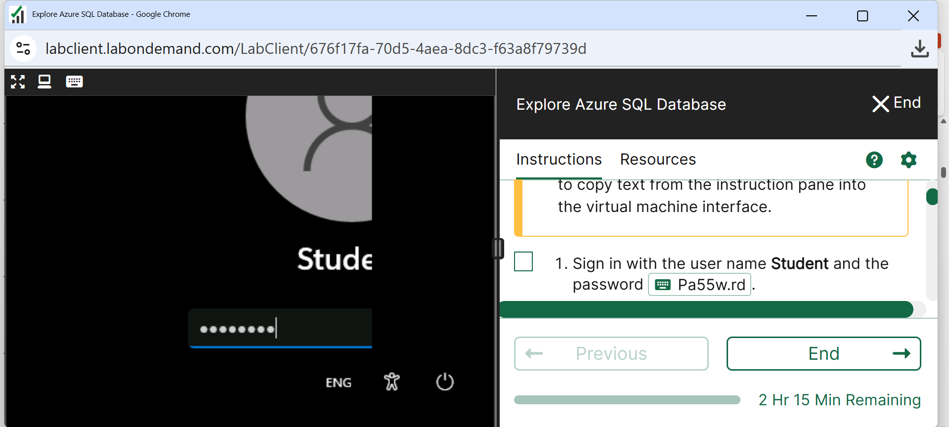
Week 9 Tutorial Activity (Step-by-Step)
Click on Password and Press Enter
Important: Do not open Azure Portal on your browser, instead run the virtual machine and then open the Azure Portal on the virtual machine’s browser

Slide 11
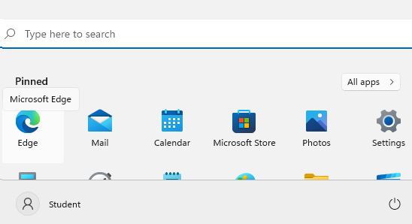
Week 9 Tutorial Activity (Step-by-Step)
Click Start and Go to Edge Browser
Important: Do not open Azure Portal on your browser, instead run the virtual machine and then open the Azure Portal on the virtual machine’s browser

Slide 12
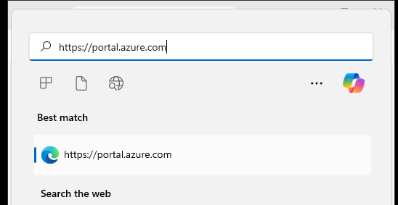
Week 9 Tutorial Activity (Step-by-Step)
Click on Website (Portal); it is on right sidebar
You will see this
Important: Do not open Azure Portal on your browser, instead run the virtual machine and then open the Azure Portal on the virtual machine’s browser

Slide 13
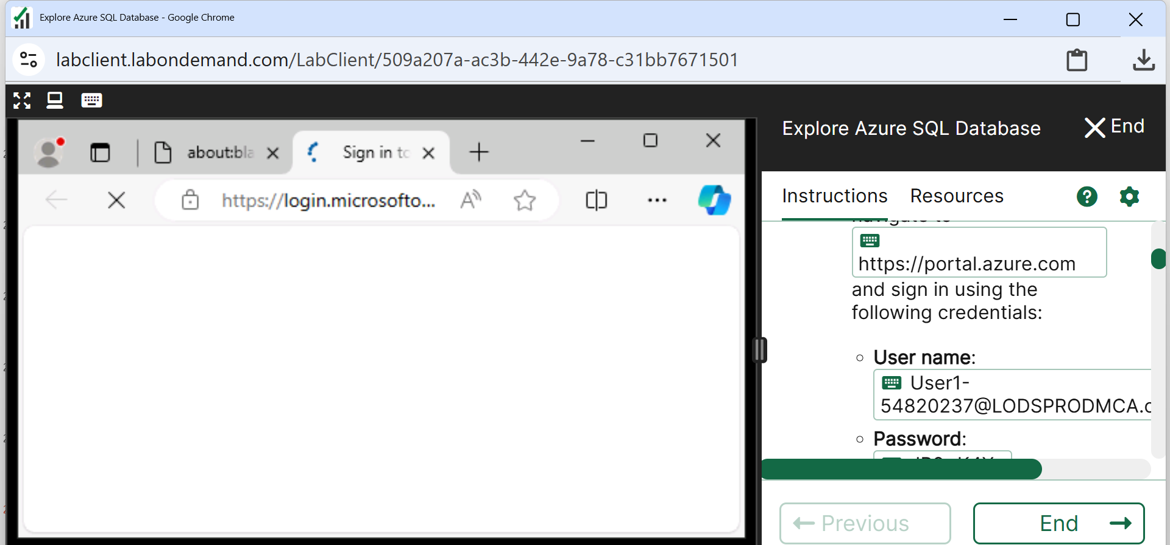
Week 9 Tutorial Activity (Step-by-Step)
Press Enter; you will see this page
Important: Do not open Azure Portal on your browser, instead run the virtual machine and then open the Azure Portal on the virtual machine’s browser

Slide 14
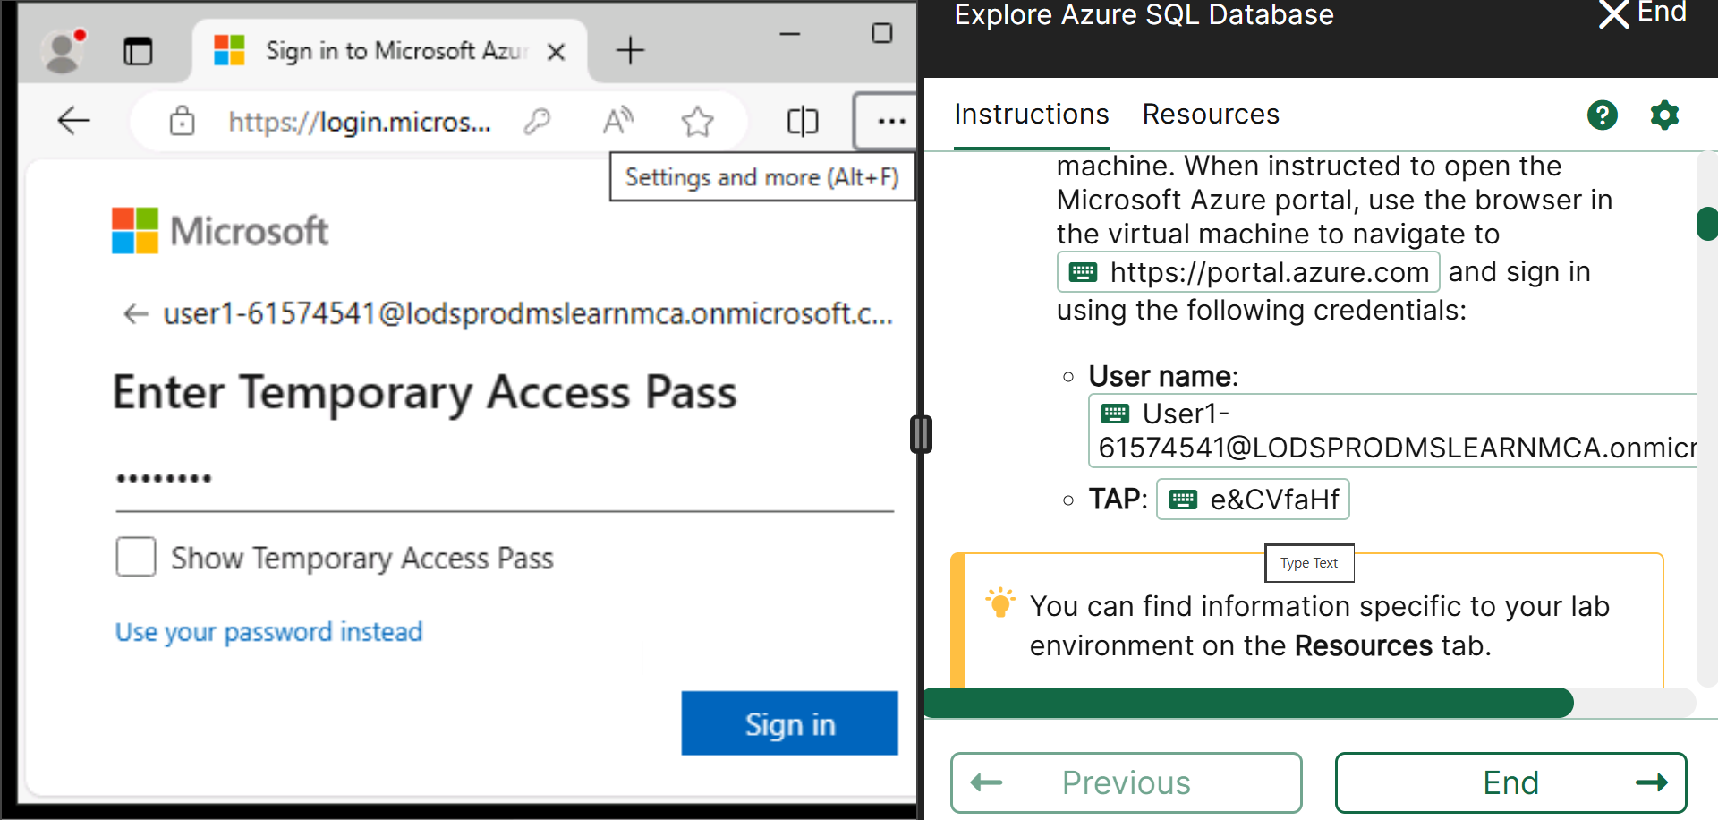
Week 9 Tutorial Activity (Step-by-Step)
Click on User and Pass (on right sidebar) to log in
Important: Do not open Azure Portal on your browser, instead run the virtual machine and then open the Azure Portal on the virtual machine’s browser

Slide 15
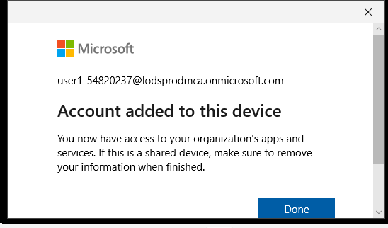
Week 9 Tutorial Activity (Step-by-Step)
Click Yes then you see this
Important: Do not open Azure Portal on your browser, instead run the virtual machine and then open the Azure Portal on the virtual machine’s browser

Slide 16
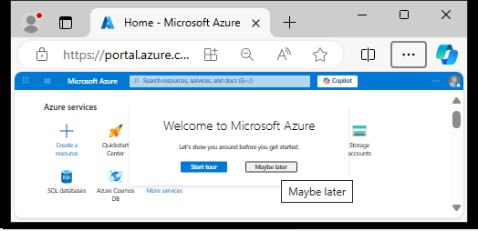
Week 9 Tutorial Activity (Step-by-Step)
Select Maybe later
Important: Do not open Azure Portal on your browser, instead run the virtual machine and then open the Azure Portal on the virtual machine’s browser

Slide 17
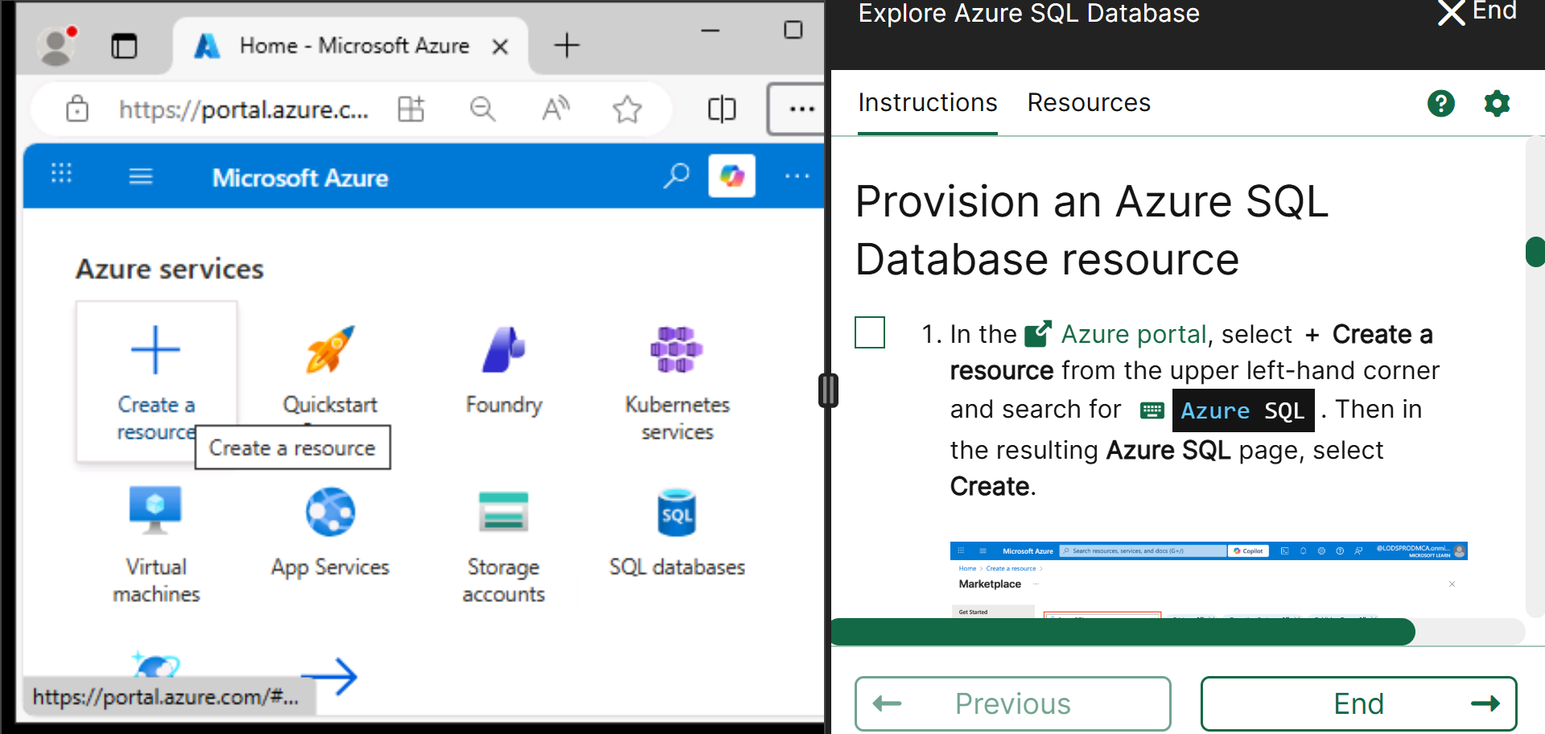
Week 9 Tutorial Activity (Step-by-Step)
Zoom in/out to see Create a Resource and Click on it
Important: Do not open Azure Portal on your browser, instead run the virtual machine and then open the Azure Portal on the virtual machine’s browser

Slide 18
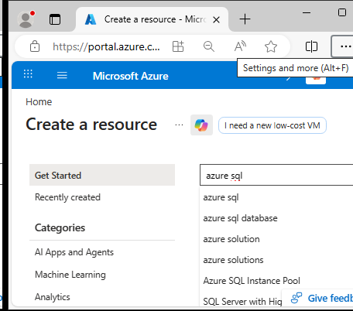
Week 9 Tutorial Activity (Step-by-Step)
Search for Azure SQL

Slide 19
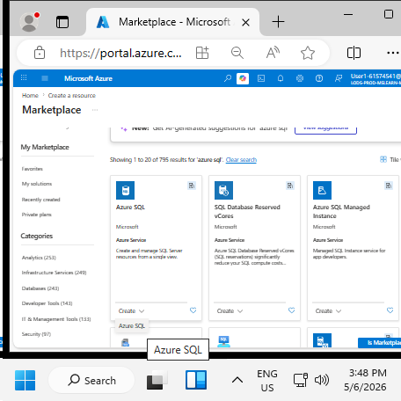
Week 9 Tutorial Activity (Step-by-Step)
Zoom in/out to see Azure SQL
Click Azure SQL

Slide 20
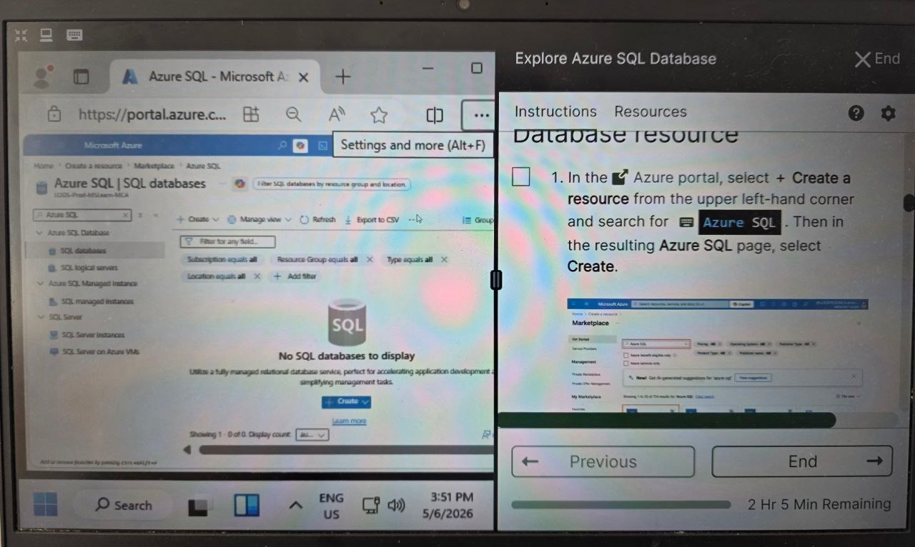
Week 9 Tutorial Activity (Step-by-Step)
Click on type on right side

Slide 21
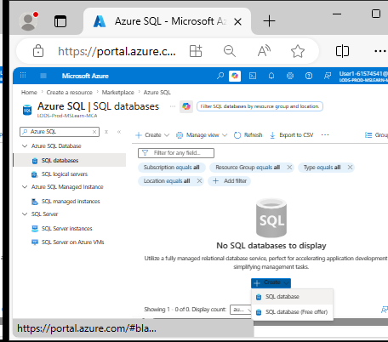
Week 9 Tutorial Activity (Step-by-Step)
Click Create >> SQL database

Slide 22
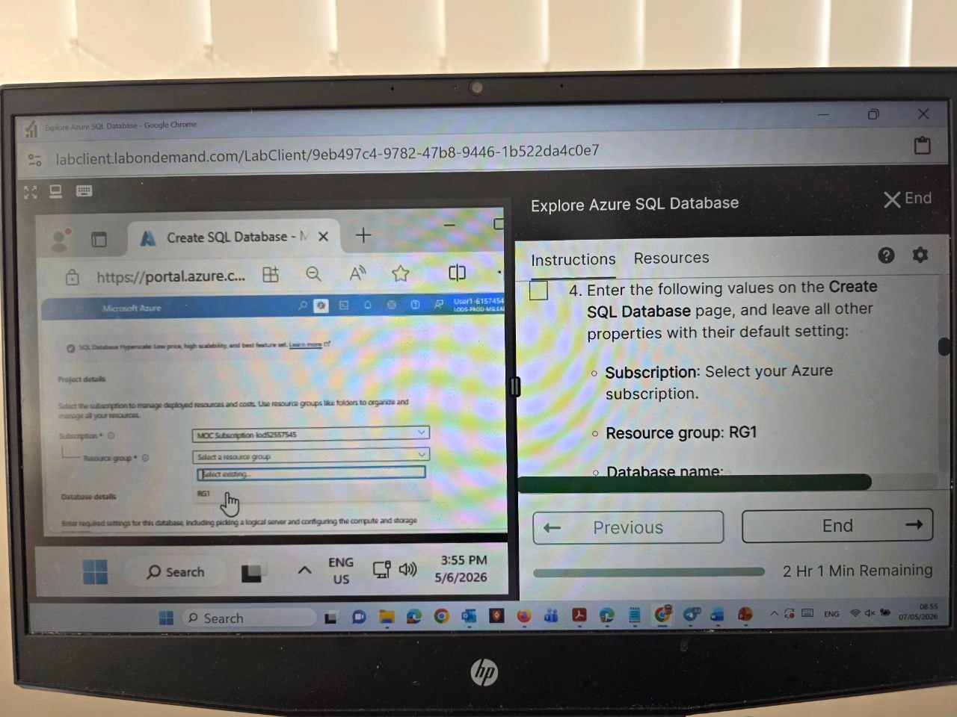
Week 9 Tutorial Activity (Step-by-Step)
The subscription should be shown automatically
Choose Resource – Type: RG1

Slide 23
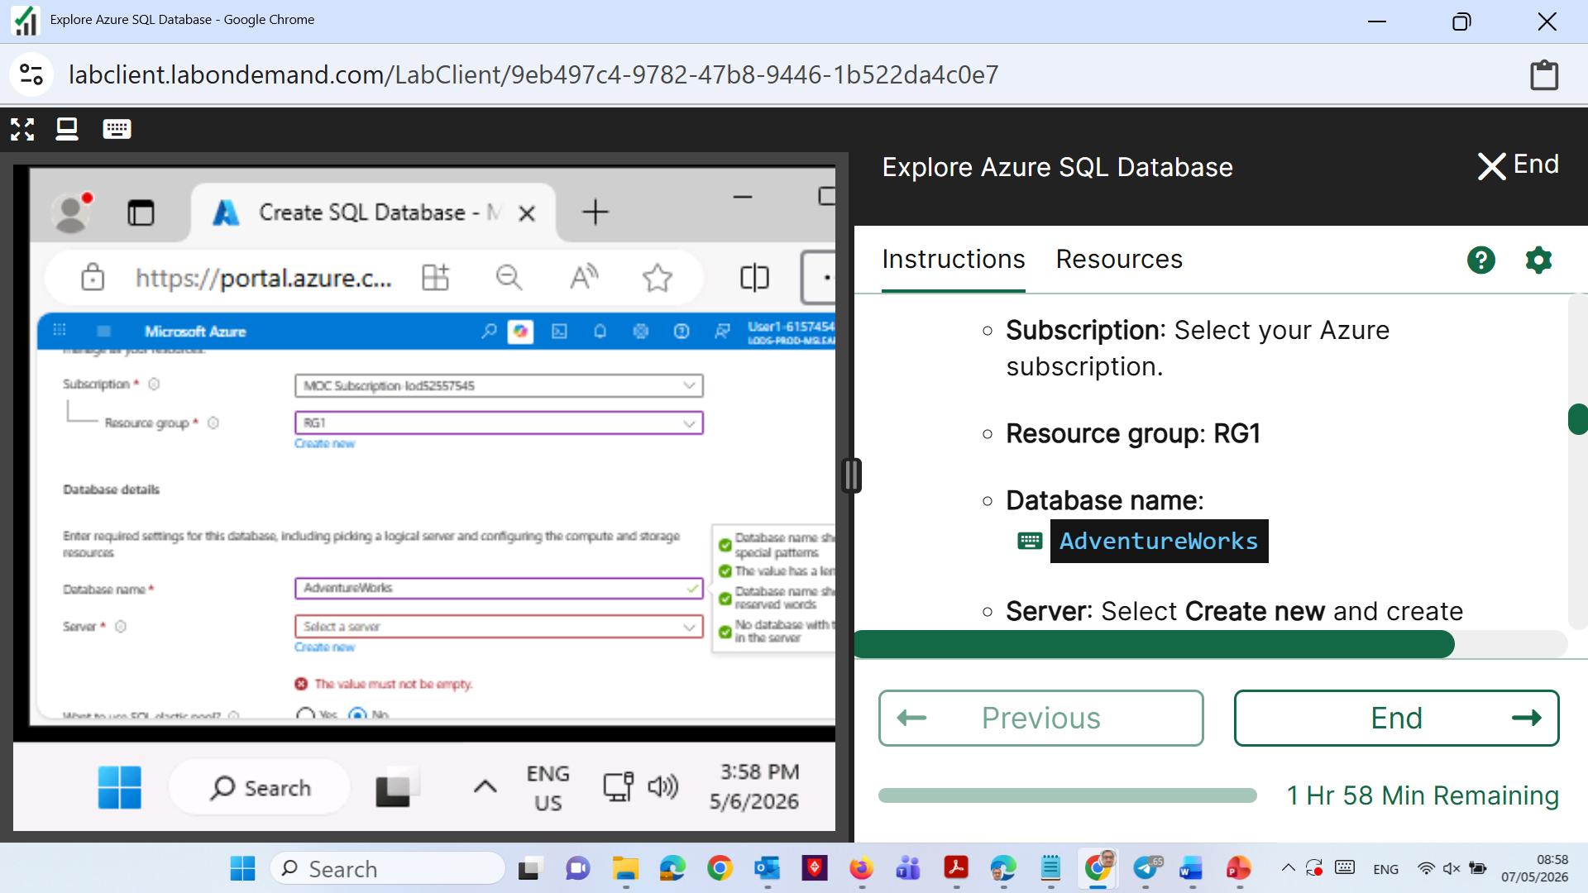
Week 9 Tutorial Activity (Step-by-Step)
I chose default one (by clicking Type the database name automatically is written)
You should follow Canvas: Student ID+name as the "database name"

Slide 24
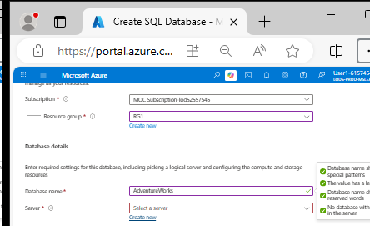
Week 9 Tutorial Activity (Step-by-Step)
Server: Create new
Make sure to use the resource group/server name and region provided on the right-hand side window.

Slide 25
Week 9 Tutorial Activity (Step-by-Step)
For the location, scroll down to find (US) West US
Do Not Choose West US2

Slide 26
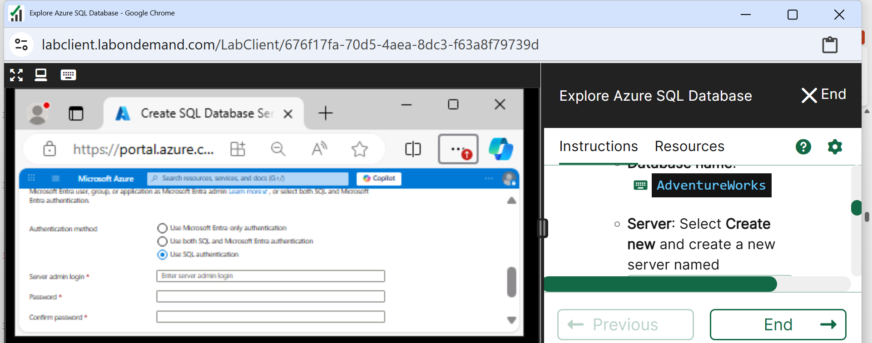
Week 9 Tutorial Activity (Step-by-Step)
SQL Authentication

Slide 27
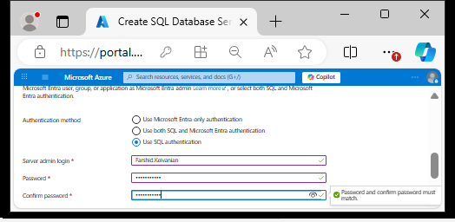
Week 9 Tutorial Activity (Step-by-Step)
Enter Your name as Server name and set a password (You will need it later) e.g., I typed Farshid.Keivanian

Slide 28
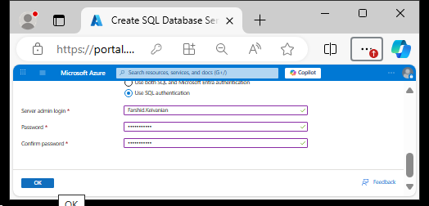
Week 9 Tutorial Activity (Step-by-Step)
Click OK

Slide 29
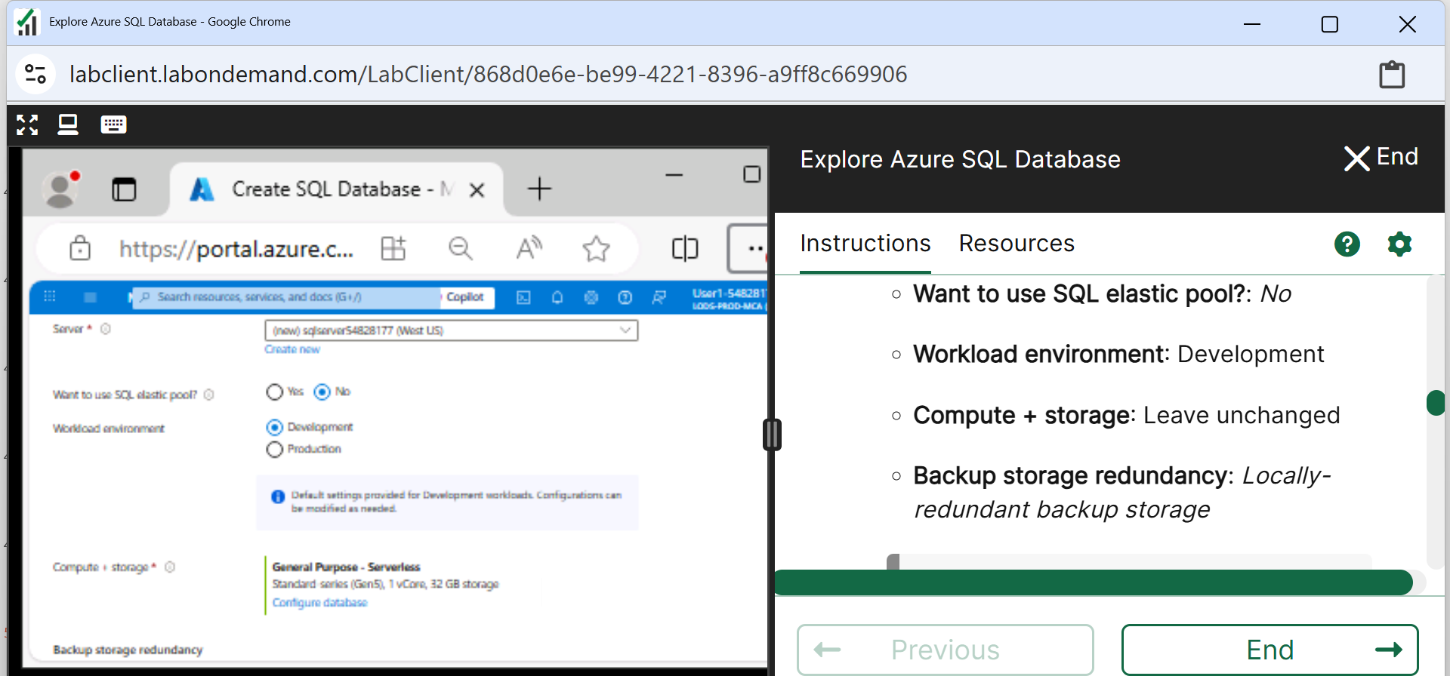
Week 9 Tutorial Activity (Step-by-Step)
Please follow the instructions on the right sidebar

Slide 30
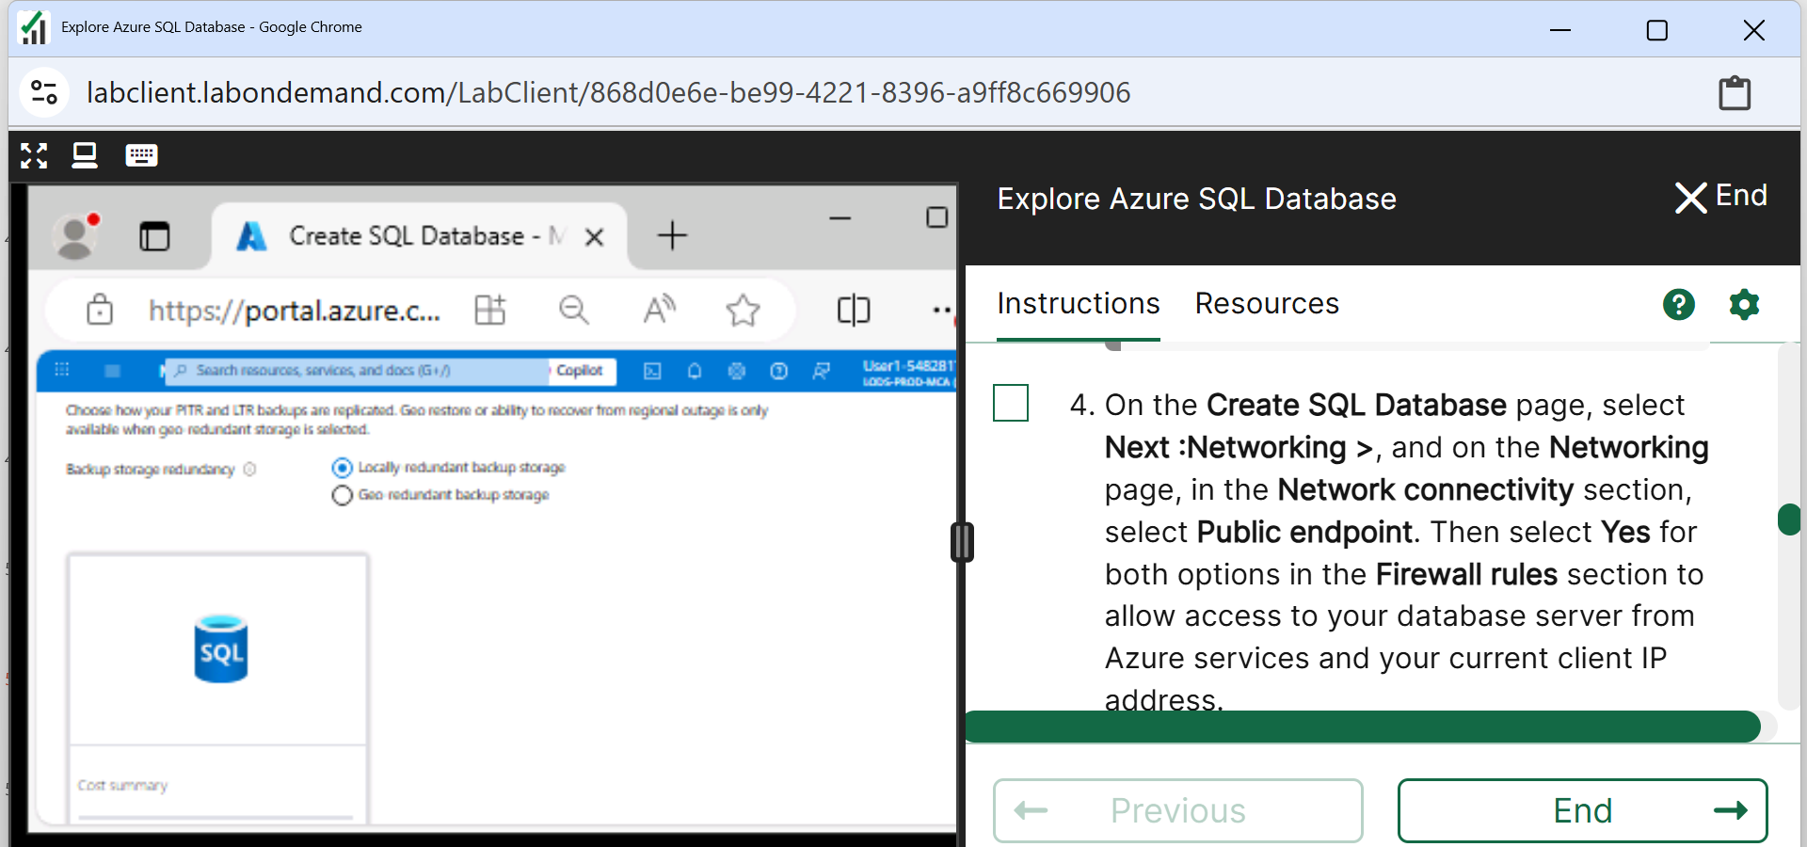
Week 9 Tutorial Activity (Step-by-Step)
Choose Locally-redundant backup storage

Slide 31
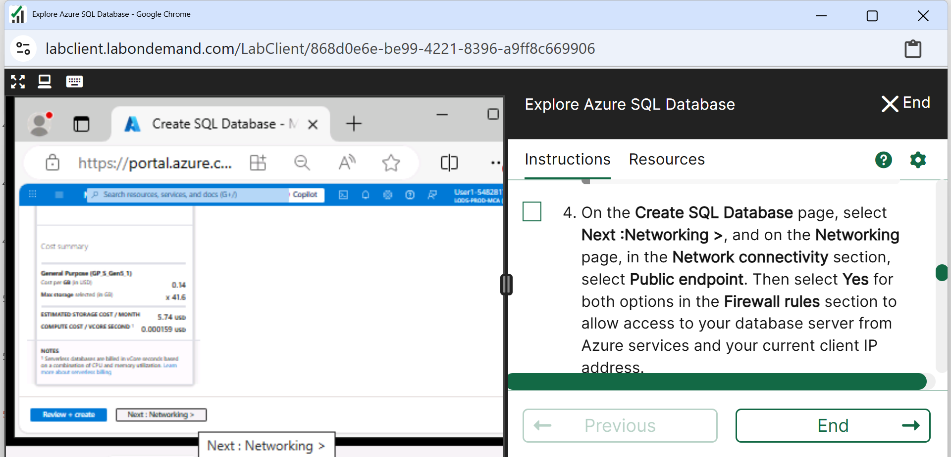
Week 9 Tutorial Activity (Step-by-Step)
Click Next: Networking

Slide 32
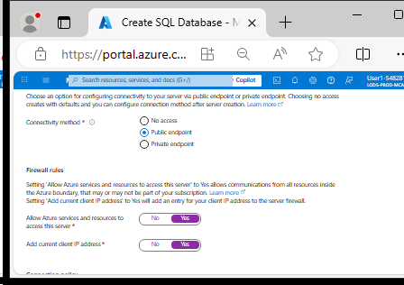
Week 9 Tutorial Activity (Step-by-Step)
Select Public endpoint, and Yes for both firewall options to allow access to your database server from Azure services and your current client IP address.

Slide 33
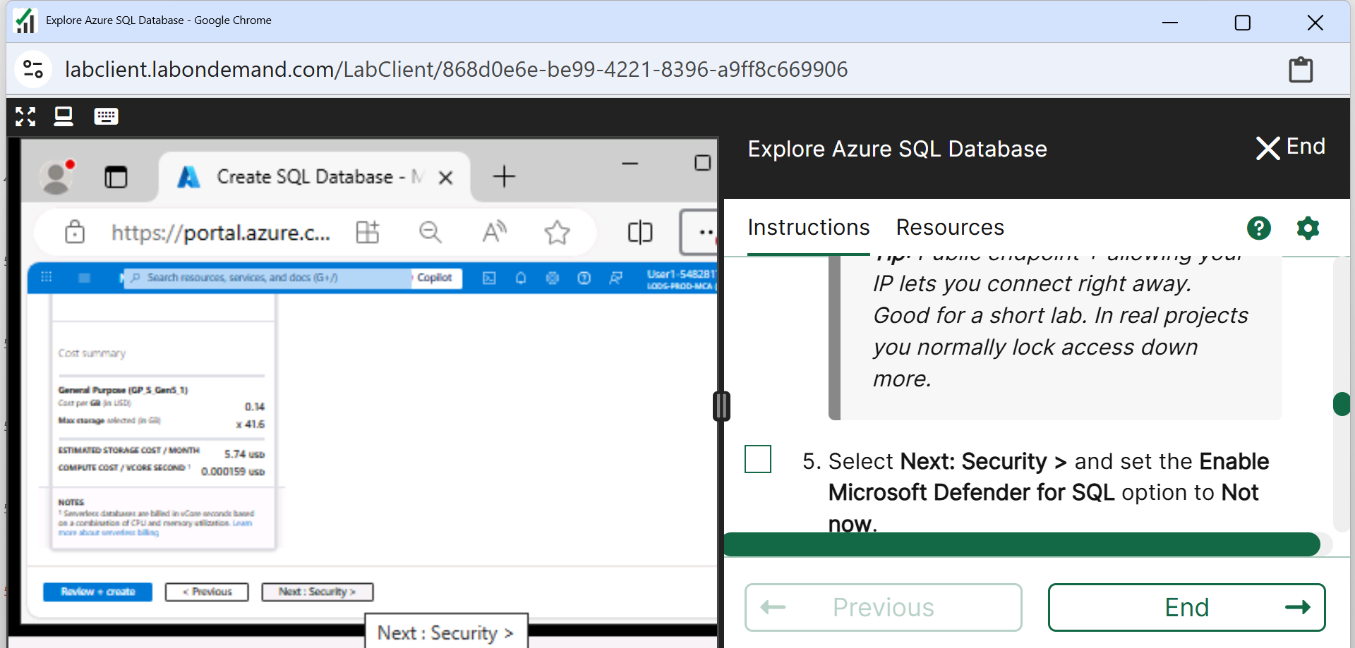
Week 9 Tutorial Activity (Step-by-Step)
Scroll Down and Click on Next: Security >

Slide 34
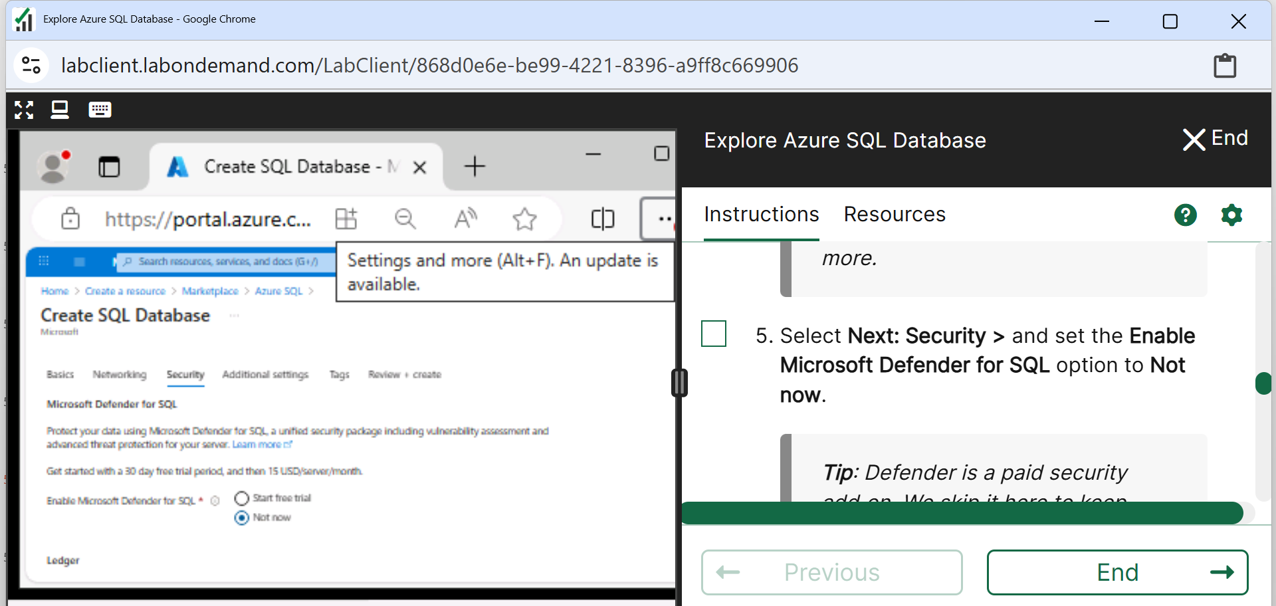
Week 9 Tutorial Activity (Step-by-Step)
Microsoft Defender: Not Now

Slide 35
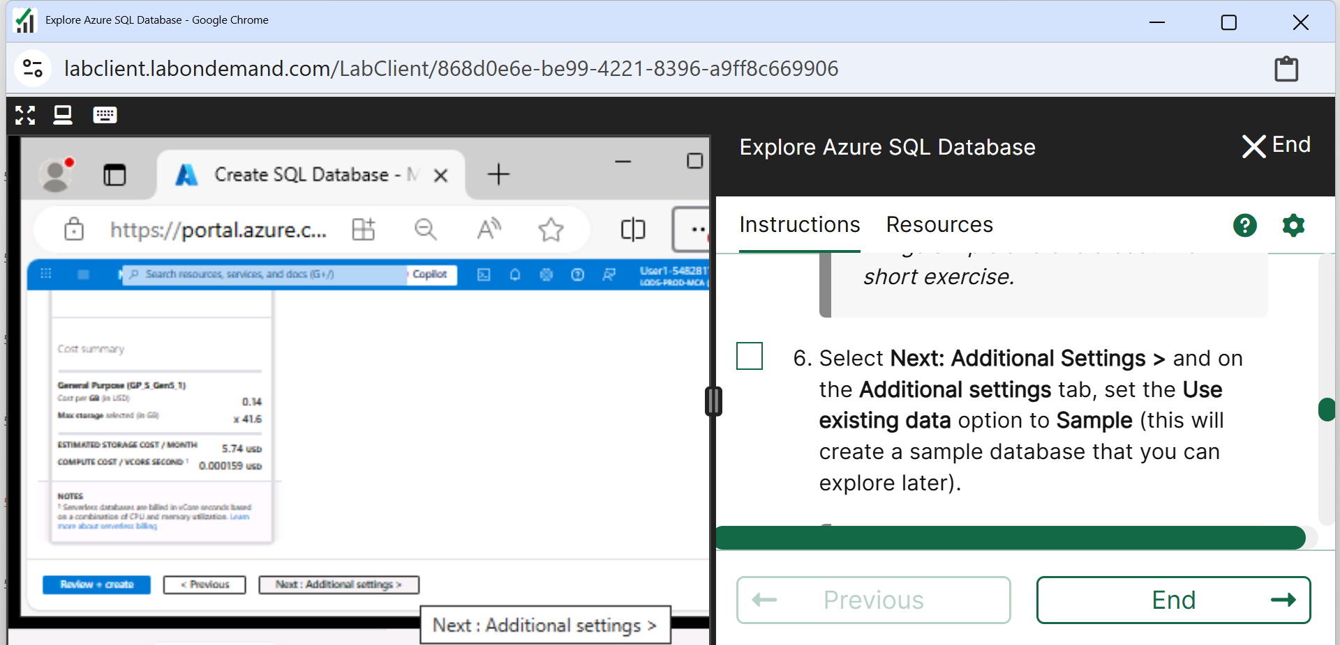
Week 9 Tutorial Activity (Step-by-Step)
Next: Additional Settings

Slide 36
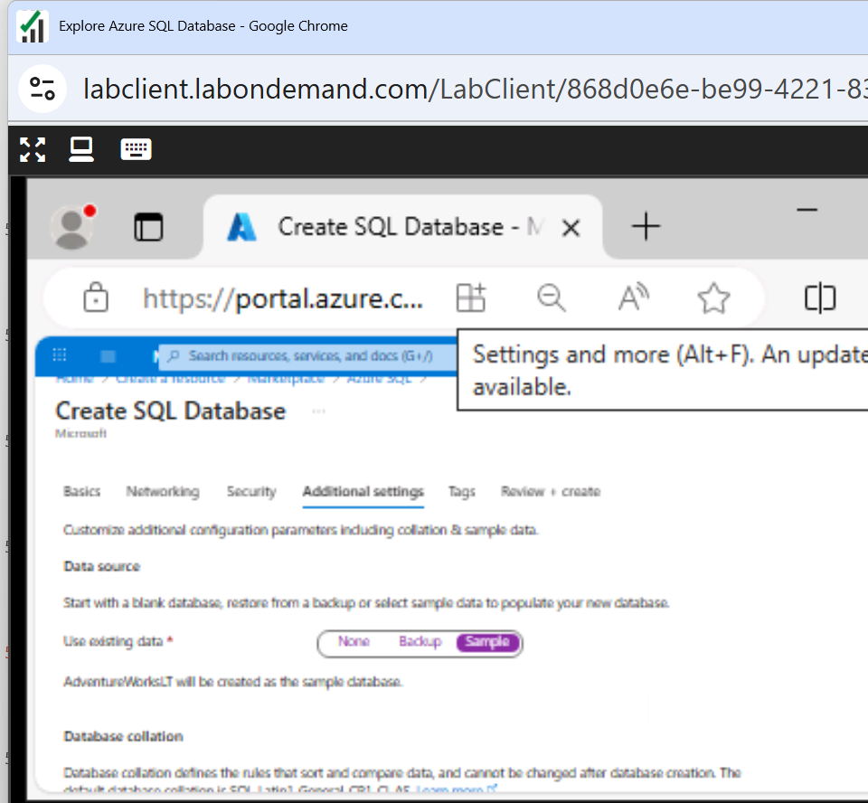
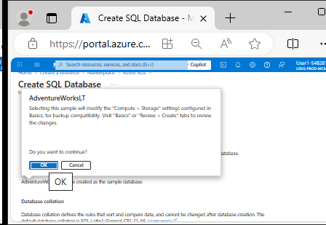
Week 9 Tutorial Activity (Step-by-Step)
Choose Sample
Click Ok to continue

Slide 37
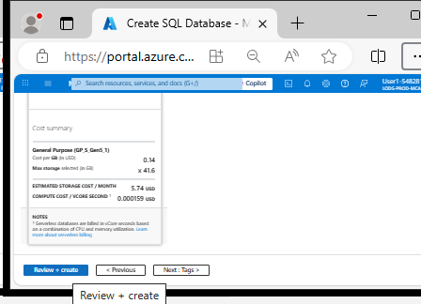
Week 9 Tutorial Activity (Step-by-Step)
Review and Create

Slide 38
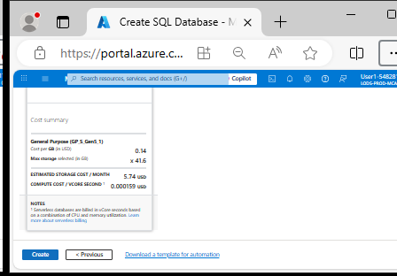
Week 9 Tutorial Activity (Step-by-Step)
Create

Slide 39
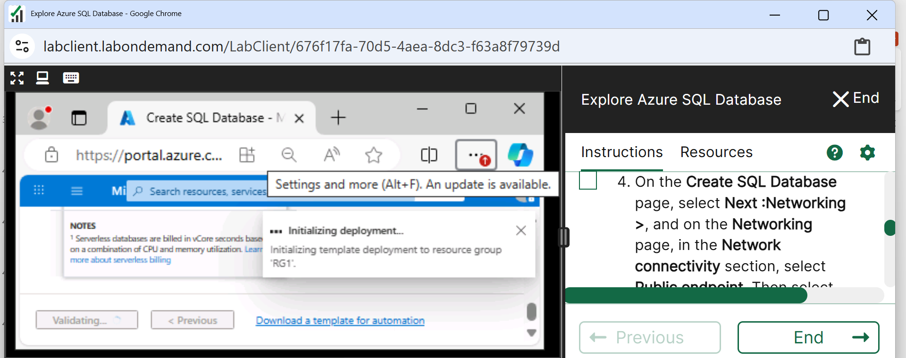
Week 9 Tutorial Activity (Step-by-Step)
Wait for deployment to complete

Slide 40
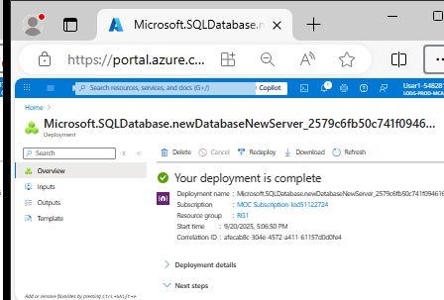
Week 9 Tutorial Activity (Step-by-Step)
Deployment is complete

Slide 41
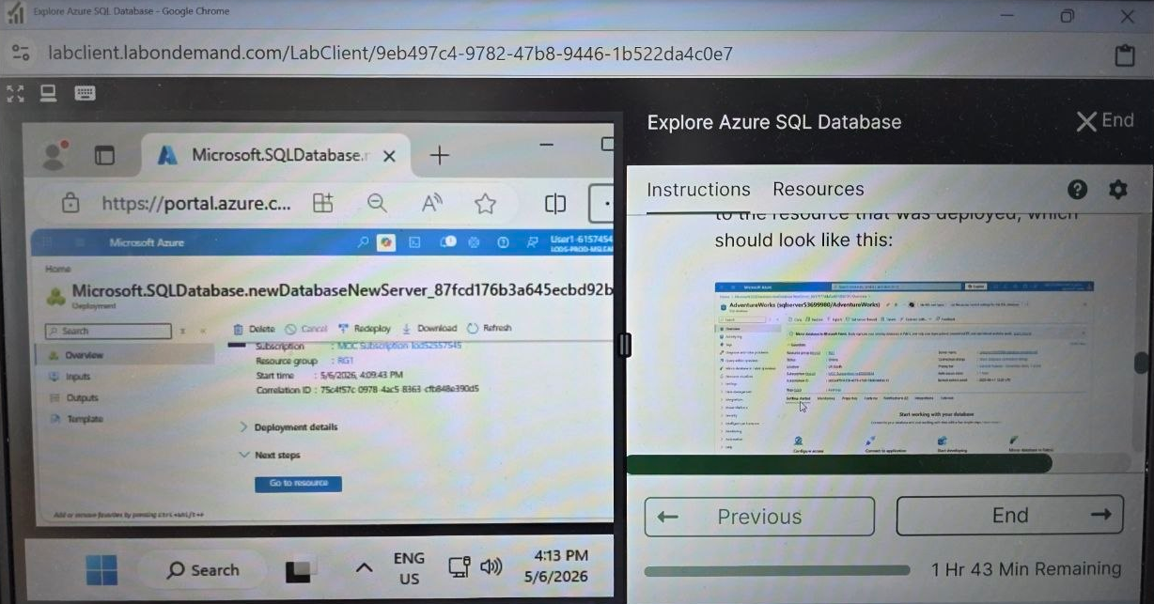
Week 9 Tutorial Activity (Step-by-Step)
Scroll Down and Go to the Resource that is now deployed

Slide 42
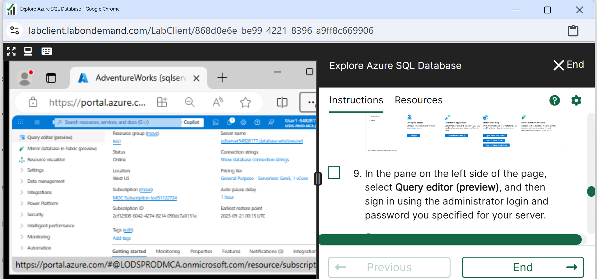
Week 9 Tutorial Activity (Step-by-Step)
Click on Query Editor (preview)

Slide 43
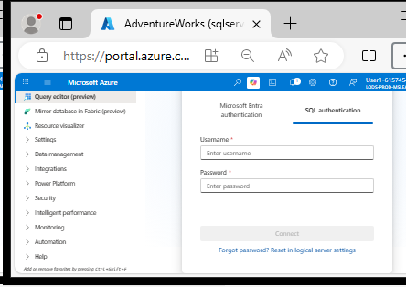
Week 9 Tutorial Activity (Step-by-Step)
Click SQL authentication

Slide 44
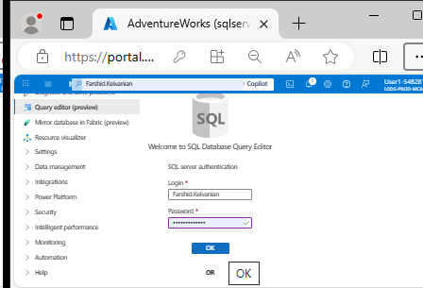
Week 9 Tutorial Activity (Step-by-Step)
Now enter your server administration log in details

Slide 45
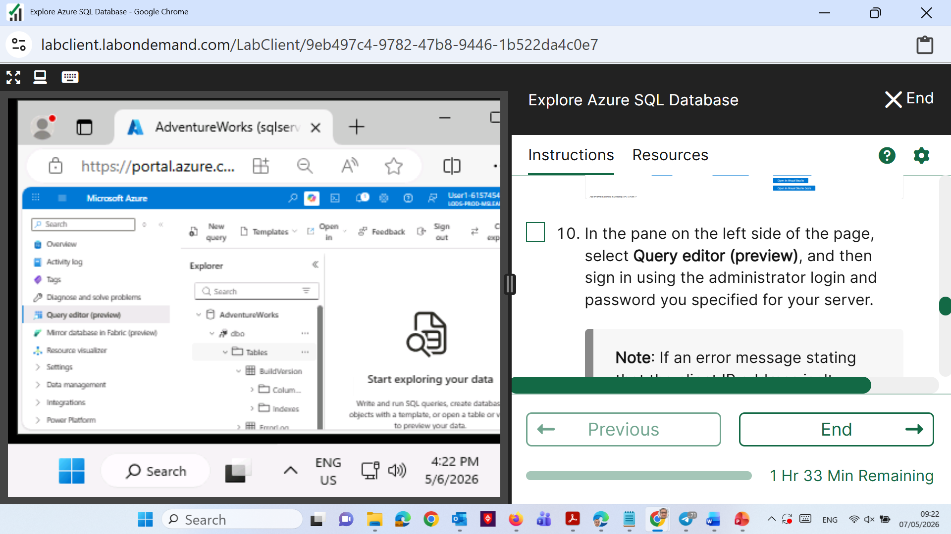
Week 9 Tutorial Activity (Step-by-Step)
You should see the Tables when you expand them

Slide 46
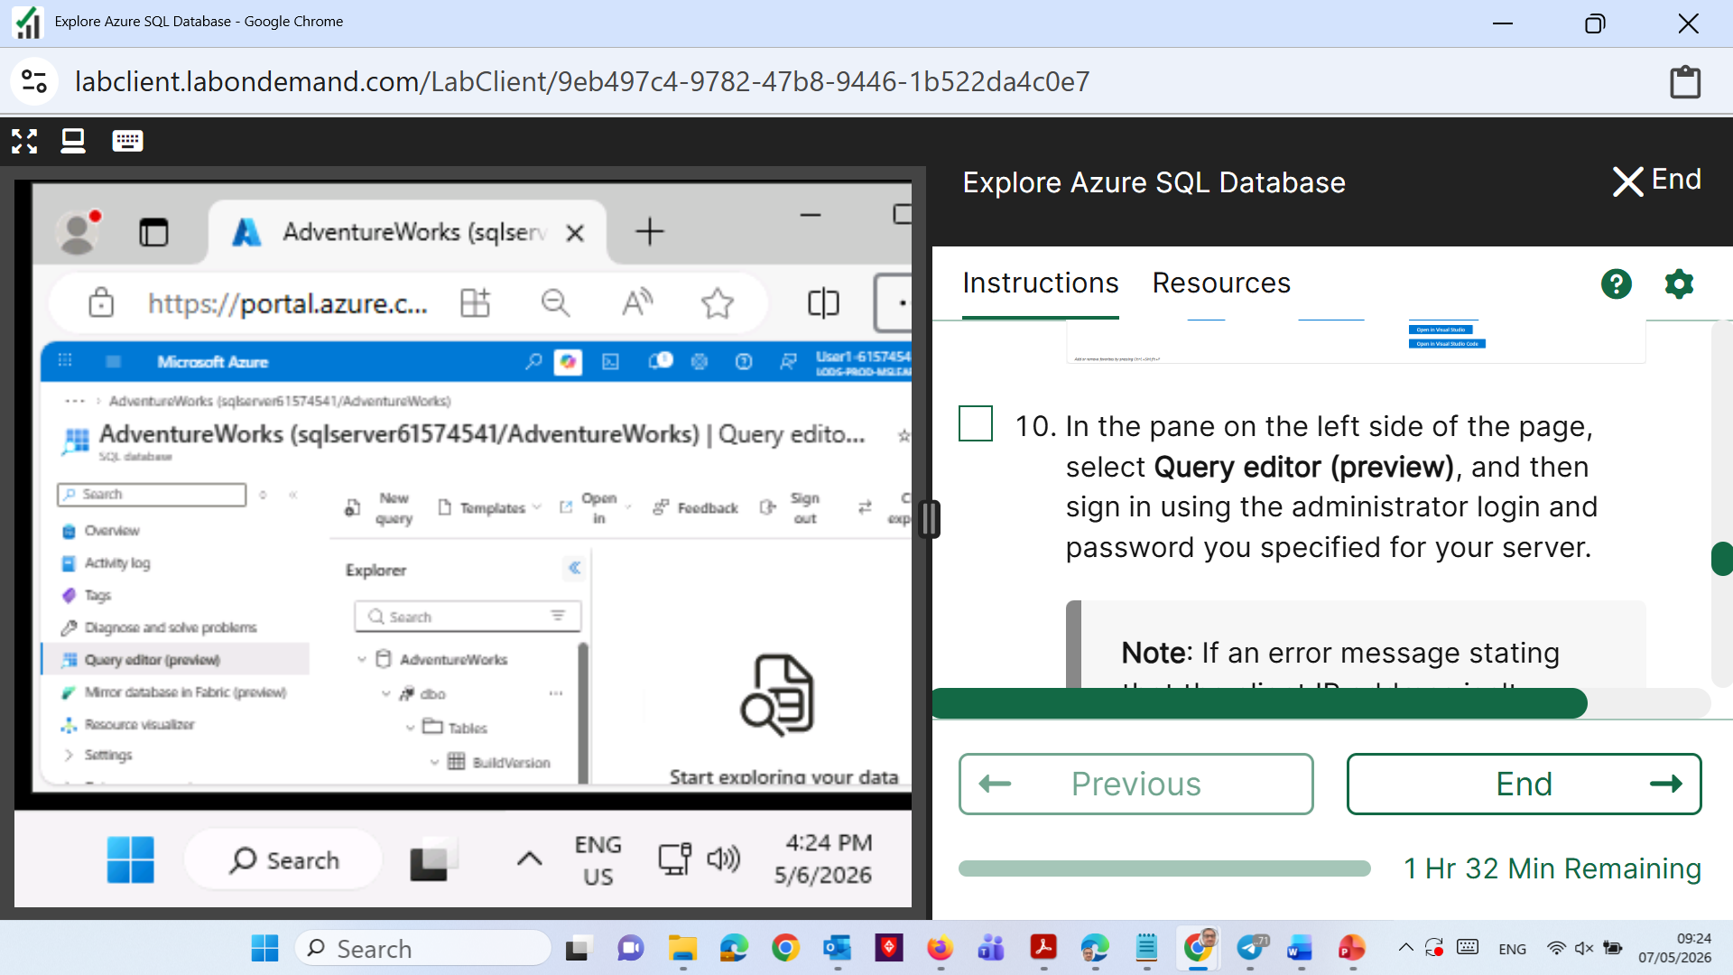
Week 9 Tutorial Activity (Step-by-Step)
Click on <<

Slide 47

Week 9 Tutorial Activity (Step-by-Step)
Click New Query

Slide 48
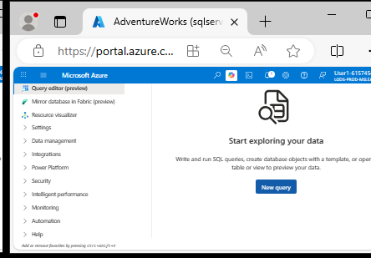
Week 9 Tutorial Activity (Step-by-Step)
Click New Query

Slide 49
Week 9 Tutorial Activity (Step-by-Step)
Scroll or refresh to view all SalesLT tables. The tutorial Week 9 queries will use
SalesLT.Customer,
SalesLT.Product,
SalesLT.ProductCategory,
SalesLT.SalesOrderHeader,
and SalesLT.SalesOrderDetail primarily.

Slide 50
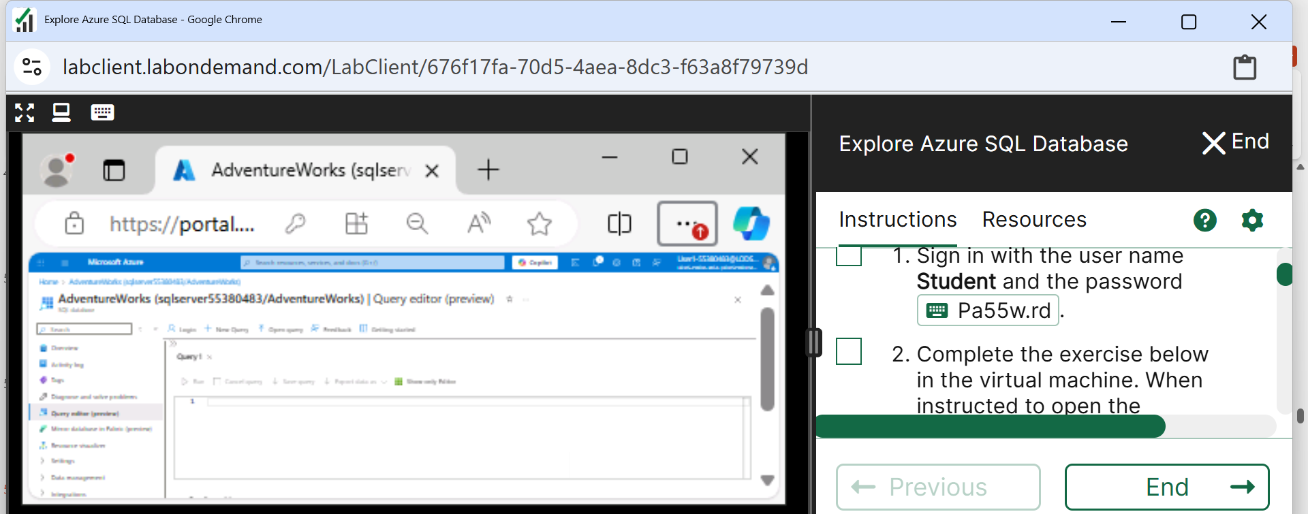
Week 9 Tutorial Activity (Step-by-Step)
Screenshot Checklist
For each query you run, take a screenshot showing:
The SQL code in the editor
The results table/output
(Optional) database name at the top

Slide 51
Week 9 Tutorial Activity (Step-by-Step)
WHAT TO TAKE SCREENSHOTS OF
For each query:
The SQL command written in the editor
The result table/output below the editor
Tip: Zoom out slightly (Ctrl + –) to fit both code and results in one screenshot.

Slide 52
Week 9 Tutorial Activity (Step-by-Step)
WHAT TO SUBMIT
Paste all 15 screenshots (or at least 6 completed ones) into one Word or PDF file.
Label each query clearly (e.g., Q1: Count Customers).
Submit via “Week 9: Tutorial Activities” link on Moodle.

Slide 53
Week 9 Tutorial Activity (Step-by-Step)
WHAT TO AVOID
X Don’t create a new Azure account (reuse Week 8 login). X Don’t skip showing both query & results in screenshots. X Don’t close the lab before saving screenshots — once it ends, data is lost.

Slide 54
Week 9 Tutorial Activity (Step-by-Step)
In the Query Editor, run each of the following SQL commands one by one. After each, take a screenshot showing:
The SQL code you typed
The output/result table

Slide 55
Week 9 Tutorial Activity (Step-by-Step)
1. Total number of customers
Take a screenshot) Shift + Enter (Or click Run)
SELECT COUNT(*) AS TotalCustomers
FROM SalesLT.Customer;
This SQL command counts how many customers are in the Customer table and shows the total number as TotalCustomers.

Slide 56
Week 9 Tutorial Activity (Step-by-Step)
1. Total number of customers
Take a screenshot) Shift + Enter (Or click Run)
SELECT COUNT(*) AS TotalCustomers
FROM SalesLT.Customer;
This code counts all the rows in the Customer table — basically, it tells us how many customers are stored in the database. Think of it like counting all entries in an Excel sheet column called Customer Name.

Slide 57
Week 9 Tutorial Activity (Step-by-Step)
1. Total number of customers
Take a screenshot) Shift + Enter (Or click Run)
SELECT COUNT(*) AS TotalCustomers
FROM SalesLT.Customer;
It’s like counting all rows in an Excel sheet that lists customer names.

Slide 58
Week 9 Tutorial Activity (Step-by-Step)
2. Names in uppercase
Take a screenshot) Shift + Enter (Or click Run)
SELECT UPPER(FirstName) AS FirstName,
UPPER(LastName) AS LastName
FROM SalesLT.Customer;
This code converts all letters to capital letters (for both first and last names). For example, “John Smith” becomes “JOHN SMITH.”

Slide 59
Week 9 Tutorial Activity (Step-by-Step)
SELECT UPPER(FirstName) AS FirstName,
UPPER(LastName) AS LastName
FROM SalesLT.Customer;
Part | Meaning | Example
SELECT | Tells the database which columns or data to show. | “Show me these fields.”
UPPER(FirstName) | Converts all letters in the FirstName column to uppercase (capital letters). | “john” → “JOHN”
AS FirstName | Gives a display name (alias) to the result column. | The result column will still be called FirstName.

Slide 60
Week 9 Tutorial Activity (Step-by-Step)
SELECT UPPER(FirstName) AS FirstName,
UPPER(LastName) AS LastName
FROM SalesLT.Customer;
UPPER(LastName) | Converts all letters in LastName to uppercase. | “smith” → “SMITH”
FROM SalesLT.Customer | Says the data comes from the Customer table inside the SalesLT database. | “Look inside the Customer table to find the names.”
This query shows every customer’s first and last name in all capital letters, making names easier to read or standardize.

Slide 61
Week 9 Tutorial Activity (Step-by-Step)
3. Total weight and average price
Take a screenshot) Shift + Enter (Or click Run)
SELECT SUM(Weight) AS TotalWeight,
AVG(ListPrice) AS AveragePrice
FROM SalesLT.Product;
This code adds up all product weights and finds the average price of products. Imagine summing all weights in a column and finding the mean of prices in Excel.

Slide 62
SELECT SUM(Weight) AS TotalWeight,
AVG(ListPrice) AS AveragePrice
FROM SalesLT.Product;
Part | Meaning | Example
SELECT | Chooses what to display in the result. | “Show me these numbers.”
SUM(Weight) | Adds up all the product weights in the Product table. | If weights are 10, 20, 30 → total = 60.
AS TotalWeight | Gives a name (alias) to the result column. | It will appear as TotalWeight in the output.
AVG(ListPrice) | Calculates the average of all product prices. | If prices are 100, 200, 300 → average = 200.

Slide 63
SELECT SUM(Weight) AS TotalWeight,
AVG(ListPrice) AS AveragePrice
FROM SalesLT.Product;
Part | Meaning | Example
AS AveragePrice | Names that result column AveragePrice. | Easier to understand in reports.
FROM SalesLT.Product | Means “get this data from the Product table.” | Looks at all products in the database.
This query tells SQL to add up all product weights and find the average product price from the Product table — just like using SUM and AVERAGE formulas in Excel.

Slide 64
Week 9 Tutorial Activity (Step-by-Step)
4. Average price per category
Take a screenshot) Shift + Enter (Or click Run)
SELECT ProductCategoryID,
SUM(Weight) AS TotalWeight,
AVG(ListPrice) AS AveragePrice
FROM SalesLT.Product
GROUP BY ProductCategoryID;
Here, data is grouped by category (like “Bikes,” “Helmets,” “T-Shirts”). It shows one row for each category — the total weight and average price for that category.

Slide 65
SELECT ProductCategoryID,
SUM(Weight) AS TotalWeight,
AVG(ListPrice) AS AveragePrice
FROM SalesLT.Product
GROUP BY ProductCategoryID;
Part | Meaning | Example
SELECT | Tells SQL what information to show in the results. | “Show me category, total weight, and average price.”
ProductCategoryID | Refers to each product’s category (like “Bikes,” “Helmets,” etc.). | Helps group products together.
SUM(Weight) | Adds up all product weights in each category. | If a category has weights 2, 3, 5 → total = 10.
AS TotalWeight | Names that total as TotalWeight in the output. | Easier to read in results.

Slide 66
SELECT ProductCategoryID,
SUM(Weight) AS TotalWeight,
AVG(ListPrice) AS AveragePrice
FROM SalesLT.Product
GROUP BY ProductCategoryID;
Part | Meaning | Example
AVG(ListPrice) | Finds the average (mean) price of all products in each category. | Prices 100, 200, 300 → average = 200.
AS AveragePrice | Gives a label to the result column. | Appears as AveragePrice.
FROM SalesLT.Product | Uses data from the Product table. | That’s where products are stored.
GROUP BY ProductCategoryID | Groups rows that have the same category ID. | So you get one result row per category.

Slide 67
SELECT ProductCategoryID,
SUM(Weight) AS TotalWeight,
AVG(ListPrice) AS AveragePrice
FROM SalesLT.Product
GROUP BY ProductCategoryID;
In short, this code groups products by their category, then shows total weight and average price for each group — like summarizing each category in a shopping catalogue.

Slide 68
Week 9 Tutorial Activity (Step-by-Step)
5. Day of week for orders
Take a screenshot) Shift + Enter (Or click Run)
SELECT OrderDate,
DATENAME(WEEKDAY, OrderDate) AS DayOfWeek
FROM SalesLT.SalesOrderHeader;
This code looks at the OrderDate column and shows which day of the week each order happened — e.g., “Monday,” “Tuesday.” It helps find patterns like “most orders happen on Fridays.”

Slide 69
SELECT OrderDate,
DATENAME(WEEKDAY, OrderDate) AS DayOfWeek
FROM SalesLT.SalesOrderHeader;
Part | Meaning | Example
SELECT | Tells SQL what data to display. | “Show me the order date and the day name.”
OrderDate | Refers to the date when each order was made. | e.g., 2025-03-12
DATENAME(WEEKDAY, OrderDate) | Finds the name of the day (like Monday, Tuesday) from that date. | e.g., 2025-03-12 → “Wednesday”
AS DayOfWeek | Gives a friendly name to the new column. | The result column will be called DayOfWeek.
FROM SalesLT.SalesOrderHeader | Gets data from the SalesOrderHeader table (where order info is stored). | Each row = one order record.

Slide 70
SELECT OrderDate,
DATENAME(WEEKDAY, OrderDate) AS DayOfWeek
FROM SalesLT.SalesOrderHeader;
This query lists every order date and shows which day of the week that order happened. It’s useful for analysing patterns — for example, finding if most sales happen on weekends.

Slide 71
Week 9 Tutorial Activity (Step-by-Step)
6. Orders by each customer
Take a screenshot) Shift + Enter (Or click Run)
SELECT CustomerID,
COUNT(SalesOrderID) AS OrderCount
FROM SalesLT.SalesOrderHeader
GROUP BY CustomerID;
This query groups all orders by customer ID and counts how many orders each customer placed. It’s like asking, “How many times did each customer buy something?”

Slide 72
SELECT CustomerID,
COUNT(SalesOrderID) AS OrderCount
FROM SalesLT.SalesOrderHeader
GROUP BY CustomerID;
Part | Meaning | Example
SELECT | Chooses what columns or calculations to show in the result. | “Show me the customer and how many orders they made.”
CustomerID | Identifies each customer (like a unique number for each person). | e.g., CustomerID = 101, 102, etc.
COUNT(SalesOrderID) | Counts how many orders each customer placed. | If a customer has 3 orders, result = 3.
AS OrderCount | Gives a friendly name to the count result column. | The column will appear as OrderCount.

Slide 73
SELECT CustomerID,
COUNT(SalesOrderID) AS OrderCount
FROM SalesLT.SalesOrderHeader
GROUP BY CustomerID;
Part | Meaning | Example
FROM SalesLT.SalesOrderHeader | Means data comes from the SalesOrderHeader table (which stores order details). | This is where all orders are listed.
GROUP BY CustomerID | Groups the data by customer so SQL can count orders per customer. | One row per customer with their total number of orders.

Slide 74
SELECT CustomerID,
COUNT(SalesOrderID) AS OrderCount
FROM SalesLT.SalesOrderHeader
GROUP BY CustomerID;
In short: This query finds how many orders each customer has made. Think of it like an Excel pivot table showing one row per customer and their total number of purchases.

Slide 75
Week 9 Tutorial Activity (Step-by-Step)
7. Days between OrderDate and DueDate
Take a screenshot) Shift + Enter (Or click Run)
SELECT OrderDate, DueDate,
DATEDIFF(day, OrderDate, DueDate) AS DaysDifference
FROM SalesLT.SalesOrderHeader;
DATEDIFF calculates how many days passed between order and due dates — helpful to measure delivery lead time.

Slide 76
SELECT OrderDate, DueDate,
DATEDIFF(day, OrderDate, DueDate) AS DaysDifference
FROM SalesLT.SalesOrderHeader;
Part | Meaning | Example
SELECT | Chooses what data to show. | “Show me order date, due date, and how many days between them.”
OrderDate, DueDate | These are the columns showing when an order was made and when it’s due. | e.g., 2025-03-01 and 2025-03-10.
DATEDIFF(day, OrderDate, DueDate) | Calculates the number of days between the two dates. | Example: 10 - 1 = 9 days difference.

Slide 77
SELECT OrderDate, DueDate,
DATEDIFF(day, OrderDate, DueDate) AS DaysDifference
FROM SalesLT.SalesOrderHeader;
Part | Meaning | Example
AS DaysDifference | Gives a friendly name to the calculated column. | The result column will show as DaysDifference.
FROM SalesLT.SalesOrderHeader | Data comes from the SalesOrderHeader table (where order details are stored). | Each row = one order record.
In short: This query shows how many days passed between when an order was made and when it’s due. It’s like checking the number of days left until the payment or delivery deadline for each order.

Slide 78
Week 9 Tutorial Activity (Step-by-Step)
8. Total products sold per ProductCategory
Take a screenshot) Shift + Enter (Or click Run)
SELECT p.ProductCategoryID,
SUM(sod.OrderQty) AS TotalSold
FROM SalesLT.SalesOrderDetail sod
JOIN SalesLT.Product p
ON sod.ProductID = p.ProductID
GROUP BY p.ProductCategoryID;
Links products with their orders and adds up quantities to show how many items were sold per category.

Slide 79
SELECT p.ProductCategoryID,
SUM(sod.OrderQty) AS TotalSold
FROM SalesLT.SalesOrderDetail sod
JOIN SalesLT.Product p
ON sod.ProductID = p.ProductID
GROUP BY p.ProductCategoryID;
Part | Meaning | Example
SELECT | Chooses which information to show. | “Show each product category and total items sold.”
p.ProductCategoryID | Refers to the category each product belongs to (from the Product table). | e.g., Bikes, Helmets, Accessories.
SUM(sod.OrderQty) | Adds up the total number of items sold per category. | If three bike orders = 2, 3, 5 → total = 10.

Slide 80
SELECT p.ProductCategoryID,
SUM(sod.OrderQty) AS TotalSold
FROM SalesLT.SalesOrderDetail sod
JOIN SalesLT.Product p
ON sod.ProductID = p.ProductID
GROUP BY p.ProductCategoryID;
Part | Meaning | Example
AS TotalSold | Gives a friendly name to the total number of sold items. | The result column will be called TotalSold.
FROM SalesLT.SalesOrderDetail sod | The main table that contains each order line (how many of each product was sold). | Think of it like an invoice detail list.
JOIN SalesLT.Product p | Combines order details with product info. | Links the product ID to find its category.

Slide 81
SELECT p.ProductCategoryID,
SUM(sod.OrderQty) AS TotalSold
FROM SalesLT.SalesOrderDetail sod
JOIN SalesLT.Product p
ON sod.ProductID = p.ProductID
GROUP BY p.ProductCategoryID;
Part | Meaning | Example
ON sod.ProductID = p.ProductID | This is the rule that connects both tables using ProductID. | Matches each order item to its product.
GROUP BY p.ProductCategoryID | Groups all products by their category to calculate totals per category. | One row per category.
This query calculates how many products were sold in each category. It joins two tables — one for orders and one for product details — to find total sales per category (like “Total Bikes sold” or “Total Helmets sold”).

Slide 82
Week 9 Tutorial Activity (Step-by-Step)
9. Top 5 customers by total order amount
Take a screenshot) Shift + Enter (Or click Run)
SELECT TOP 5 CustomerID,
SUM(TotalDue) AS TotalAmount,
COUNT(SalesOrderID) AS OrdersPlaced
FROM SalesLT.SalesOrderHeader
GROUP BY CustomerID
ORDER BY TotalAmount DESC;
Adds up all payments per customer, sorts by the biggest spenders, and shows only the top 5.

Slide 83
SELECT TOP 5 CustomerID,
SUM(TotalDue) AS TotalAmount,
COUNT(SalesOrderID) AS OrdersPlaced
FROM SalesLT.SalesOrderHeader
GROUP BY CustomerID
ORDER BY TotalAmount DESC;
Part | Meaning | Example
SELECT | Chooses what information to show. | “Show me the customer, their total spending, and number of orders.”
TOP 5 | Limits results to the top 5 customers. | Only the 5 highest-spending customers are displayed.
CustomerID | Identifies each customer. | e.g., CustomerID = 101, 102, etc.
SUM(TotalDue) | Adds up how much each customer has spent overall. | If a customer placed 3 orders worth $100, $200, and $50 → Total = $350.

Slide 84
SELECT TOP 5 CustomerID,
SUM(TotalDue) AS TotalAmount,
COUNT(SalesOrderID) AS OrdersPlaced
FROM SalesLT.SalesOrderHeader
GROUP BY CustomerID
ORDER BY TotalAmount DESC;
Part | Meaning | Example
AS TotalAmount | Gives a friendly name to the total spending column. | It appears as “TotalAmount” in the results.
COUNT(SalesOrderID) | Counts how many orders each customer placed. | If a customer has 3 orders → result = 3.
AS OrdersPlaced | Renames that count result as “OrdersPlaced.” | Easier to read in output.
FROM SalesLT.SalesOrderHeader | Data is taken from the order records table. | This is where all sales transactions are listed.

Slide 85
SELECT TOP 5 CustomerID,
SUM(TotalDue) AS TotalAmount,
COUNT(SalesOrderID) AS OrdersPlaced
FROM SalesLT.SalesOrderHeader
GROUP BY CustomerID
ORDER BY TotalAmount DESC;
Part | Meaning | Example
GROUP BY CustomerID | Groups results by customer so each row = one customer. | Calculates totals per customer.
ORDER BY TotalAmount DESC | Sorts the results from highest to lowest total spending. | Shows biggest spenders first
In short: This query finds the top 5 customers who spent the most money, showing their total amount spent and how many orders they placed. It’s like a leaderboard of your best customers based on total purchases.

Slide 86
Week 9 Tutorial Activity (Step-by-Step)
10. Average days between OrderDate and ShipDate
Take a screenshot) Shift + Enter (Or click Run)
Finds the average number of days it takes to ship an order — useful for checking delivery performance.
SELECT AVG(DATEDIFF(day, OrderDate, ShipDate)) AS AverageDaysToShip
FROM SalesLT.SalesOrderHeader
WHERE ShipDate IS NOT NULL;

Slide 87
Week 9 Tutorial Activity (Step-by-Step)
11. Total profit per product
Take a screenshot) Shift + Enter (Or click Run)
SELECT p.ProductID,
SUM((p.ListPrice - p.StandardCost) * sod.OrderQty) AS TotalProfit
FROM SalesLT.Product p
JOIN SalesLT.SalesOrderDetail sod
ON p.ProductID = sod.ProductID
GROUP BY p.ProductID;
Calculates profit by subtracting cost from price and multiplying by quantity sold. Groups by product to see which ones earn the most.

Slide 88
SELECT p.ProductID,
SUM((p.ListPrice - p.StandardCost) * sod.OrderQty) AS TotalProfit
FROM SalesLT.Product p
JOIN SalesLT.SalesOrderDetail sod
ON p.ProductID = sod.ProductID
GROUP BY p.ProductID;
Part | Meaning | Example
SELECT | Chooses what to show in the result. | “Show each product and how much total profit it made.”
p.ProductID | The ID number of each product from the Product table. | e.g., ProductID = 101 for “Mountain Bike.”
(p.ListPrice - p.StandardCost) | Finds the profit per item by subtracting the cost from the selling price. | e.g., Price $100 – Cost $60 = $40 profit per item.
* sod.OrderQty | Multiplies that profit by how many units were sold. | e.g., $40 × 10 = $400 total profit.

Slide 89
SELECT p.ProductID,
SUM((p.ListPrice - p.StandardCost) * sod.OrderQty) AS TotalProfit
FROM SalesLT.Product p
JOIN SalesLT.SalesOrderDetail sod
ON p.ProductID = sod.ProductID
GROUP BY p.ProductID;
Part | Meaning | Example
SUM(...) AS TotalProfit | Adds up all profits for each product (across all orders). | If Product 101 was sold 3 times → total all those profits together.
FROM SalesLT.Product p | The main product list (contains price and cost). | Think of it as your “catalogue.”
JOIN SalesLT.SalesOrderDetail sod | Combines product info with order details. | Links what was sold to what the product actually is.
ON p.ProductID = sod.ProductID | Connects both tables using the ProductID field. | Matches each order line with its product.

Slide 90
SELECT p.ProductID,
SUM((p.ListPrice - p.StandardCost) * sod.OrderQty) AS TotalProfit
FROM SalesLT.Product p
JOIN SalesLT.SalesOrderDetail sod
ON p.ProductID = sod.ProductID
GROUP BY p.ProductID;
Part | Meaning | Example
GROUP BY p.ProductID | Groups the results so each product shows once, with its total profit. | One row per product.

Slide 91
SELECT p.ProductID,
SUM((p.ListPrice - p.StandardCost) * sod.OrderQty) AS TotalProfit
FROM SalesLT.Product p
JOIN SalesLT.SalesOrderDetail sod
ON p.ProductID = sod.ProductID
GROUP BY p.ProductID;
In short: This query calculates total profit for each product by:
subtracting cost from price,
multiplying by how many were sold,
then adding them all up per product.
Analogy: It’s like checking the profit report in a store — for each item, it tells how much money the store earned after covering costs.

Slide 92
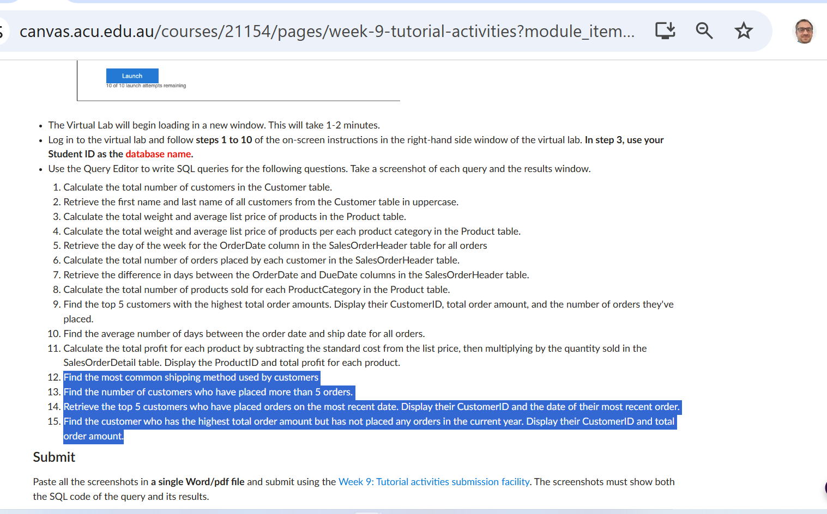
Week 9 Tutorial Activity (Step-by-Step)
Please continue writing the remaining queries for tasks 12 to 15

Slide 93
What we learned
How to use SQL to explore and analyse relational data.
How to write basic and intermediate queries using SELECT, COUNT, SUM, AVG, GROUP BY, and DATE functions.
How to combine results from multiple tables with joins (in later tasks).

Slide 94
Why this is important
SQL is one of the core data-management skills in every data-related or IT role. Almost every Australian company—from banks like Commonwealth Bank to healthcare and retail—relies on SQL for:
Reporting and analytics
Cleaning and preparing data
Supporting web or cloud applications

Slide 95
Industry Insights & Graduate Expectations
Graduates who know SQL are expected to:
Write queries to extract and summarise data efficiently
Understand relational database design (tables, keys, joins)
Analyse performance, detect anomalies, and create dashboards In Australia, jobs such as Data Analyst, Database Administrator, BI Developer, and Software Engineer almost always list SQL proficiency as a must-have skill.

Slide 96
Thank You
Have a Great Learning Day!
Feel free to reach out with any questions!
Dr. Farshid Keivanian

